Slide 1
CSC 455: Database Processing for Large-Scale Analytics
Lecture 9
Alexander Rasin
College of CDM, DePaul University
November 19th, 2013

Slide 2
Tonight
Python
RegExp
Materialized views
Streaming DB Engines
NoSQL
MapReduce

Slide 3
Python Functions
max/min/avg
max([['key1',4], ['key2', 6], ['key3', 5]])
max([['key1',4], ['key2', 6], ['key3', 5]], key=lambda x:x[1])
sort
list1 = [['key1',4], ['key2', 6], ['key3', 5]]
list1.sort(reverse=True)
list1.sort(reverse=True, key = lambda x: x[1])

Slide 4
Regular Expressions
import re
regex1 = re.compile('created_at')
regex1.findall(tweet)
regex2 = re.compile('created_at":"[^"]*"')
regex2.findall(tweet)
regex3 = re.compile('"\w+":"[^"]*"')
regex4 = re.compile('"\w+":null')
regex12 = re.compile('created_at":"[^"]*".*"\w+":null')
Notes:
http://rasinsrv07.cstcis.cti.depaul.edu/CSC455/getTweetData.py

Slide 5
Regular Expressions
email = "Sure,\n Steve's password is 12345 and Ana's password is DePaul9 and I think Chris' password is Chris."
regex5 = re.compile("[A-Z][a-z]+\'s? password is \w+")
regex6 = re.compile("[A-Z][a-z]+\'s? password is (\w+)")
for password in regex6.findall(email):
email = email.replace(password, 'REDACTED!')

Slide 6
Project
Document posted
Due in 1 week
  Take-home final

Slide 7
Indexes
An index is an auxiliary data structure constructed to speed up accesses to a data file
An index is associated with a particular indexing field (which may be an indexing key)
An index is stored in a separate index file
  Each record contains a value of the indexing field, and a block address
  The index file is sorted on the indexing field

Slide 8
A simple index
Index file
Brighton A-217 700
Downtown A-101 500
Downtown A-110 600
Mianus A-215 700
Perry A-102 400
......
A-101
A-102
A-110
A-215
A-217
......
Index of depositors on acct_no
Index records: <search key value, pointer (block, offset or slot#)>
To answer a query for “acct_no=A-110” we:
1. Do a binary search on index file, searching for A-110
2. Follow pointer of index record

Slide 9
Views
A view is a “virtual table”
  create view dept_tot_salary(dept_name, tot_salary) as select dept_name, sum(salary)
  from instructor
  group by dept_name
Does not do much to optimize queries
  Security
  Convenience
  (Possibly) query optimization

Slide 10
Materialized Views
Views are nearly cost-free
Automatically updated (with table changes)
… but not very useful
Materialized Views
  Compute and store the query
  Use the view data directly
  Space cost
  Maintenance cost
Dept_Name | SUM(Salary)
Comp. Sci. | 10M
Music | 2M
Economics | 11M
History | 1M
Comics Studies | 500K
Numerology | 750K

Slide 11
Using Materialized Views
Materialized View (MV) is similar to a pre-computed query
  Simpler language semantics
Best case, Q_{i} = MV_{i}
  Maintenance and disk space limitations
Otherwise a lot of work to use
  Pre-join
  Pre-filtered
  Pre-aggregated

Slide 12
Pre-filtered Materialized View
Filter out the relevant rows
  E.g., create view for salary > 75,000
Smaller than the table
Not useful for queries with salary > 74,000

Slide 13
Pre-joined Materialized View
Join tables and store as view
No longer need to perform joins
  Combine with normalization
Potentially much larger than source table
  Redundancy

Slide 14
Pre-aggregated Materialized View
Pre-compute the aggregation
  E.g., average salary by department
Irreversible but smaller
Can be aggregated further

Slide 15
Materialized View Maintenance
The task of keeping a materialized view up-to-date with the underlying data is know as materialized view maintenance
Materialized views using incremental view maintenance
  Changes do database relations are used to compute changes to the materialized view, which is then updated

Slide 16
MV Maintenance
Pre-filtered
  Propagate relevant rows (ignore others)
Pre-joined
  Execute all relevant joins (expensive!)
  Then propagate updates
Pre-aggregated
  For sum/avg can just add new value
  What about delete/min/max?

Slide 17
Tuning
By default, key fields are indexed
Deciding which fields to index should be based on statistical analysis of frequent queries
need to consider SELECT as well as INSERT, UPDATE and DELETE

Slide 18
Files and Indexes in Oracle SQL
Can create index-organized tables, with a primary index (B-tree) on the primary key
CREATE TABLE TABLENAME
(
…define table, with primary key…
)
ORGANIZATION INDEX;

Slide 19
Files and Indexes in other DBs
MySQL: Choice of various storage engines
  MyISAM: Unordered file with B-tree index
  InnoDB: Ordered file with B-tree index
SQL Server
  Allows re-clustering the table on any index at any time (if not unique a uniquefier is introduced)
PostgreSQL:
  Allows index-based re-clustering, but doesn’t maintain the clustered order automatically
DB2
  Similar to PostreSQL (manual REORG)

Slide 20
SQLite
No materialized views
Can use
  CREATE TABLE … AS SELECT
  (no primary keys/constraints)

Slide 21
Autoincrement in SQLite
conn = sqlite3.connect('TestDB.db')
c = conn.cursor()
c.execute("CREATE TABLE MyTable (f1 NUMBER, f2 VARCHAR(50))")
c.execute('INSERT INTO MyTable VALUES (100, "Hello")');
c.execute("SELECT rowid, f1, f2 FROM MyTable").fetchall()

Slide 22
Autoincrement in SQLite
c.execute("CREATE TABLE MyTable2 (ID INTEGER PRIMARY KEY AUTOINCREMENT, f1 NUMBER, f2 VARCHAR(50))")
c.execute("INSERT INTO MyTable2(f1,f2) VALUES (200, 'Test')");
c.execute("INSERT INTO MyTable2(f1,f2) VALUES (300, 'Test3')");
c.execute("SELECT * FROM MyTable2").fetchall()
c.execute("SELECT rowid, ID, f1, f2 FROM MyTable2").fetchall()
c.execute("INSERT INTO MyTable2(id, f1,f2) VALUES (500, 300, 'Test3')");
c.execute("INSERT INTO MyTable2(f1,f2) VALUES (400, 'Test4')");

Slide 23

BREAK

Slide 24
Object Databases
Based on objects rather than relations
Each object has a identity, state, and behaviors (i.e., instance variables and methods)
Object Database Management Systems:
  Define databases using Object Definition Language
  Retrieve information using Object Query Language
Yield more complicated designs than the relational model

Slide 25
Object-Relational Databases
Some of the benefits of object databases can be realized by incorporating objects into the relational model
Object-relational databases are usually backward compatible with RDBMSs
Oracle-specific reference:
http://infolab.stanford.edu/~ullman/fcdb/oracle/or-objects.html

Slide 26
Defining Classes
Can create classes as user-defined types:
  CREATE [OR REPLACE] TYPE TYPENAME
  AS OBJECT
  (
  …instance variables and domains…
  …method declarations…
  );
  /

Slide 27
Creating Objects
Each class has a constructor that is automatically defined
Takes arguments corresponding to instance variables
Use NEW operator to create a new object instance and assign to object variable

Slide 28
Declaring Methods
Method declarations go into CREATE TYPE statement
  MEMBER PROCEDURE
  name(…list parameters…)
  …or…
  MEMBER FUNCTION
  name(…list parameters…) RETURN type

Slide 29
Defining Methods
Method definitions go into separate CREATE TYPE BODY statement
  CREATE TYPE BODY TYPE AS
  MEMBER FUNCTION name(...list parameters…) RETURN type IS
  BEGIN
  … statements…
  return expression;
  END;
  END;
  /

Slide 30
Adding Objects to Tables
Objects from user-defined types can be inserted into tables as part of a row in two ways:
  Call the constructor within the INSERT INTO … VALUES … statement
  Use an object that has already been declared

Slide 31
Querying Tables with Objects
Queries follow the usual SELECT … FROM … WHERE … form
Must create an alias in the FROM clause:
FROM TABLE alias
Use alias.Attribute to access any attribute
If alias.Attribute is an object, can access members with alias.Attribute.member (add arguments for methods…)

Slide 32
Streaming Data
Types of data (infinite)
  Sensor data
  Stock market quotes
  Network monitoring data
Types of queries
  One pass (cannot rewind or store)
  Report last day average
  Report changes in sensor data
  Collect information about single user

Slide 33
Stream Processing
U
Σ
μ
Data
Sources
Client
Apps
U
μ
Σ
Data sources push tuples continuously
Operators process windows of tuples

Slide 34
Operations
Filter the stream
  E.g., select (temperature > 100)
Aggregate the stream
  # of cars entered the garage
    Window (per-hour? Over last hour?)
Join two streams
  Match “buy” and “sell” offers
  Windows on each side

Slide 35
NoSQL
No SQL / Not Only SQL
Non-relational databases (data-store) systems
Relax some of the relational database rules
  Integrity constraints
  Rigid schema
  Update/synchronization guarantees
  Better scalability

Slide 36
Key Value Stores
For a (key, value) combination
  Key is a key
  Value is a “blob”
  Insert
  Update
  Delete
  Get
Many implementations
  DynamoDB, Riak, Redis, BerkeleyDB, …

Slide 37
Document Stores
Similar to key value stores
Value is not a blob, but a document, e.g.
  {"Subject": "I like Plankton“
  "Author": "Rusty"
  "PostedDate": "5/23/2006"
  "Tags": ["plankton", "baseball", "decisions"]
  "Body": "I decided today that I don't like baseball. I like plankton." }
You may have heard of
  MongoDB, CouchDB, Terrastore, RavenDB

Slide 38
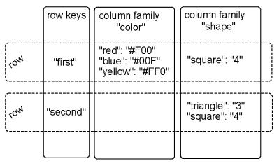
Column Family Stores
Similar to document stores
Add the concept of “column family”
Helps optimize read access and updates
  HBase, Cassandra, Amazon SimpleDB

Slide 39
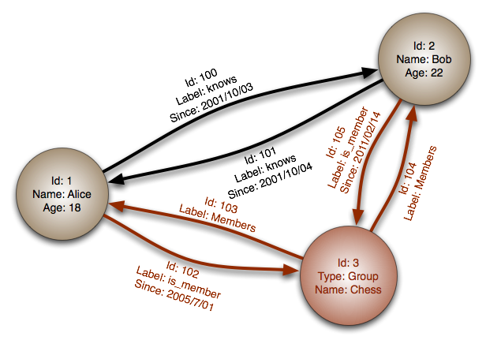
Graph Databases
Database stores the set of items
Items are connected to each other
Query recursively
DBs
  Neo4j
  InfiniteGraph
  OrientDB

Slide 40
MapReduce
Concept developed by Google
  Large array of inexpensive machines
  (Potentially) imprecise queries
  Relaxed integrity constraints
  Scale-out vs scale-up
MapReduce program consists of
  Map
  Reduce

Slide 41
Scale-out vs Scale-up
Many smaller servers
Harder to manage
Easier to expand
Easier to tolerate failure (*)
Generally cheaper
Few large servers
Easier to manage
Difficult/expensive to expand
Failure is a serious setback
More expensive

Slide 42
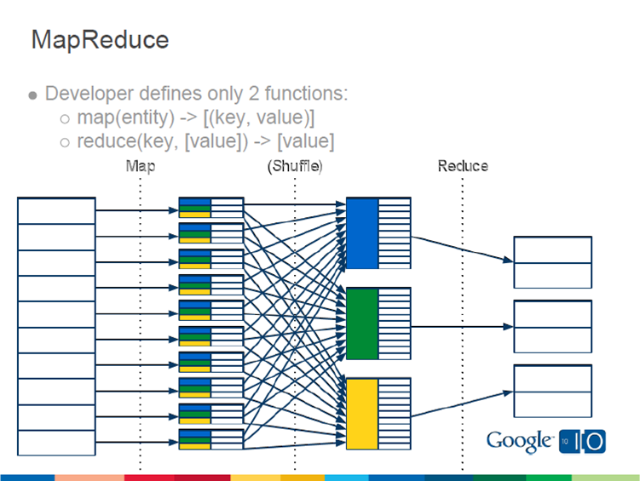
MapReduce Flow

Slide 43



